Slide 1
SQL FUNCTIONS

Slide 2
Functions
Functions are very powerful feature of SQL used to manipulate data items .
SQL functions are built into oracle database and are operated for use in various appropriate SQL statements.

Slide 3
SQL FUNCTION Diagrammatic Representation
Functions
Arg 1
Function performs action
arg2
Resullt value
Arg n

Slide 4
Advantages of function
Function can be used to perform complex calculations on data.
Functions can modify individual data items
Function can very easily manipulate output for groups of rows.
Function can manipulate character as well as numeric type of data.
function can alter date formats for display

Slide 5
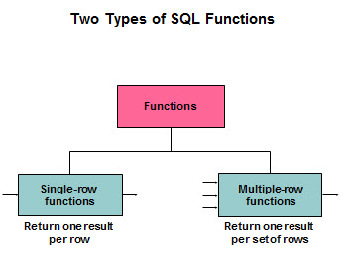
TYPES OF FUNCTION
There are two types of function:

Slide 6
Single row function
These function operate on single rows only and return one value for ach row, column name or an expression. Single-row functions can be used in SELECT. WHERE and ORDER by clauses.
Syntax of using a single-row function is function_name [(arg1, arg2,…..)]
Where, function_name is the name of the function. arg1,arg2 is any argument to be used by the function. This can be represented by a user-supplied constant value, variable value, column name or an expression.

Slide 7
Types of single row functions
Character functions
arithmetic functions
Date functions
conversion functions
General functions
Aggregate functions

Slide 8
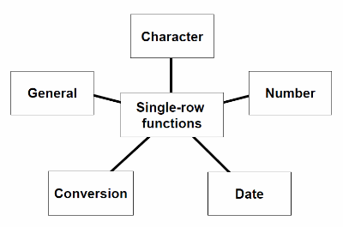

Slide 9
String/character function
1.LOWER:- returns char, with all letters in lowercase.
Syntax:-lower(char)
e.g. select lower(‘IVAN BAYROSS’) from dual;
Output=ivan bayross

Slide 10
2.INITCAP:- returns a string with the first letter of each word in upper case.
Syntax:- initcap(char)
e.g. select initcap(‘IVAN BAYROSS’) from dual;
Output=Ivan Bayross

Slide 11
3.UPPER:- returns char, with all letters in uppercase.
syntax:- upper(char)
e.g. select upper(‘ivan bayross’) from dual;
Output= IVAN BAYROSS

Slide 12
4.SUBSTR:-returns a portion of characters beginning at character m, and going up to character n. if n is omitted the result returned is up to the last character in the string. The first position of char is 1.
Syntax:- substr(<string>,<start_position>,[<length>])

Slide 13
Where string is source string
start_position is the position for extraction. The first position in the string is always 1.
Length is the number of character is extract.
e.g. select substr(“secure”,3,4) from dual;
Output= cure

Slide 14
5.ASCII:-returns the number code that represents the specified character. If more than one character is entered, the function will return the value for the first character and ignore all the characters after the first.
syntax:-ascii(character)
e.g. select ascii(‘a’) from dual;
ouput= 97

Slide 15
6.LENGTH:- returns a length of a word.
Syntax:- length(word)
e.g. select length(‘sharanam’) from dual;
Output= 8

Slide 16
Continue;

Slide 17
NUMERIC FUNCTIONS…..
1. ABS:- returns the absolute value of ‘n’.
syntax:- ABS(-15)
e.g. Select ABS(-15) from dual;
2.POWER:- returns m raised to the nth power. n must be an integer else an error is returned.
syntax:-power(m,n)
e.g. Select power(3,2) from dual;

Slide 18
3.Round:-returns n, rounded to m places to the right of the decimal point.
m must be an integer
syntax:-round(n,[m])
e.g. select round(15.91,1) from dual;
output=15.2
4.SQRT:- returns square root of n.
syntax:-sqrt(n)
e.g. select sqrt(25) from dual;
output=5

Slide 19
5.EXP:-returns e raised t the nth power where e=2.71828183
syntax:- exp(n)
E.g. select exp(5) from dual;
Output=148.413159
6.EXTRACT:-returns a value extracted from a date or an integer value. A date can be used only to extract year, month and day, while a timestamp with a time zone data type can be used only to extract timezone_hour and timezone_minute.
E.g. select extract(year from date ‘2004-07- 02’)”year”, extract(month from sysdate)”month” from dual;
Output=2004 7

Slide 20
9.MOD :-returns the remainder of a first number divided by second number passed a parameter. If the second number is zero the result of the same as the first number
Syntax:-mod(m,n)
e.g. select mod(15,7) from dual;
Output= 1

Slide 21
11. FLOOR:- return a largest integer value that is equal to less than a number.
Syntax:-floor(n)
e.g. select floor(24.8) from dual;
Output=24
12.CEIL:-return the smallest integer value that is greater than or equal to a number.
Syntax:-ceil(n)
e.g. select ceil(24.8) from dual;
Output= 25

